Slide 1
Delivering with ABC
Introduction
October 2022
Innovative, experienced, benefits driven IT Consulting business focused on driving client success through the implementation of the Keystone solution.

Slide 2
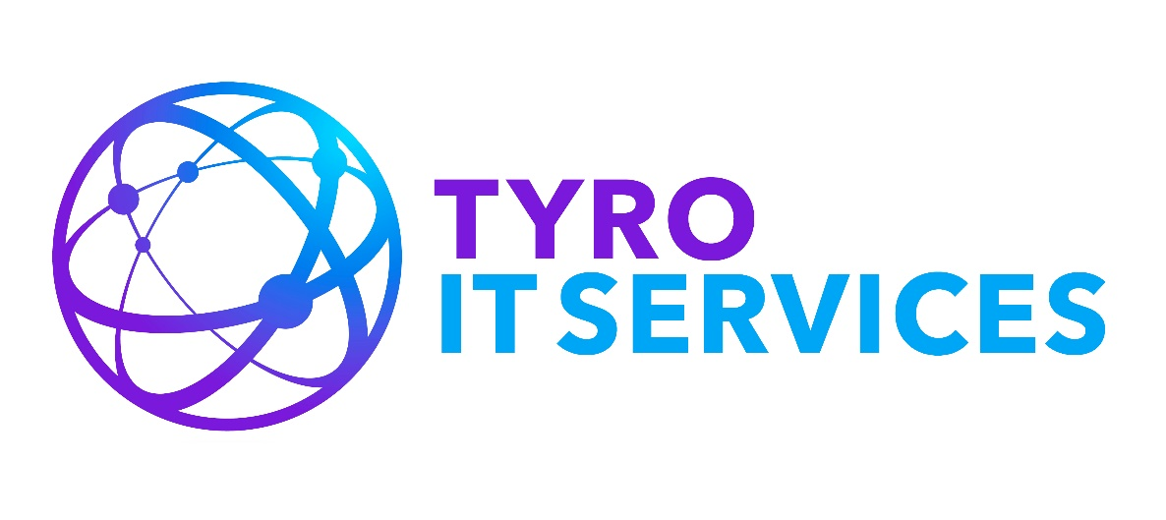
Introduction
The traditional System Integrator model can be seen as outdated, costly, cumbersome and lengthy.
Tyro Transformation as a Service allows a more agile program approach with:
Up to 75% quicker realisation.
Over 50% cost savings.
Delivery teams of only highly rated experts.
Project flexibility- roll on, roll off to meet demand and pay as you go.
Enable
Evolve
Educate
Control of your journey, save time and money, embrace Transformation as a Service.
5

Slide 3
Methodology
You can deliver transformation quickly within your organisation, but might need help in some areas;
TaaS provides a Pay As You Go set of expert services in a model that suits your requirements and is driven by delivering value to your business
We can provide the best expert resources, coach resources or provide the best service for you.
5

Slide 4
Why OLX
You know what you want and need some help achieving it.
You have in house capability and need additional expert help and coaching.
You are flexible, pragmatic and accessible – we are working for you, as part of your extended team.
You expect a high quality partner to help lead and deliver with you.
You do have a business culture that we understand and know out to complement it.
Your organisation is growing rapidly and is in the perfect place to benefit from this approach.
Enable
Evolve
Educate
5

Slide 5
Why is the right support function important
You need to continue adding value to the business.
You need to continually evolve;
You operate in different global locations but want to drive consistency and efficiency;
You have mission critical solutions and processes that operate that help to operate the business;
You have invested significantly in business transformation activities and solutions;
You operate in a competitive environment;
Enable
Evolve
Educate
5

Slide 6
Common mistakes
Desktop Support: The support organisation is much more than IT Support and needs to cover all areas from Business Process Improvement to User and Data Management;
Resource Strategically: Support staff may not be the implementation staff and it is important to ensure the correct blend of professionals who know how to support a business;
Plan to Change: Change and Release management ensures that evolution can continue and benefit the business with little or no critical impact;
Business Cost: Support is a set of services provided to the business that should be monitored and assessed continuously, to drive and add value to the business
Enable
Evolve
Educate
5

Slide 7
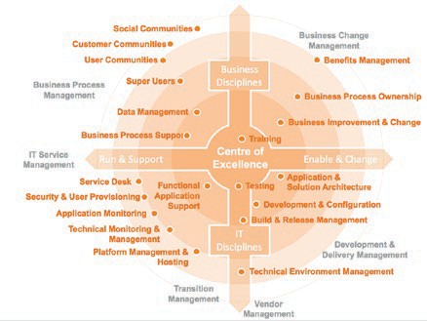
Models
We have significant experience in creating and improving support organisations both locally and globally;
It is important that the support model continues to help drive the benefits for the business case and we have a comprehensive model that focuses of people and process to ensure we help you have the best model that works for your requirements;
Enable
Evolve
Educate
5

Slide 8
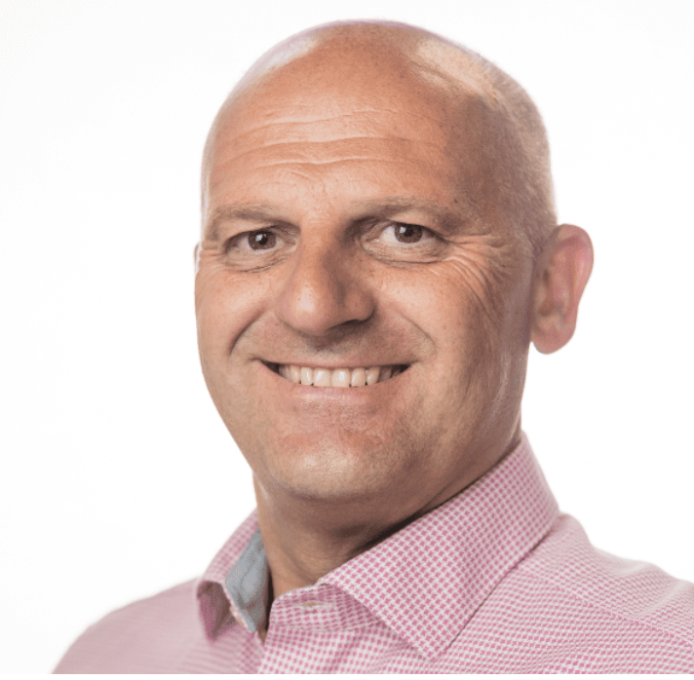
Common mistakes
Creating a partnership to provide experts services delivering to your business outcomes we can help you with:
Delivery Assurance
Client and Account Management
Programme and Project Management
Architectural, Testing and Business Enablement Services
Operating and Support Models
We will help assess your people and then work with you to coach and enable them to succeed in the future with out us.
We will work with you to develop and grow your internal practise capability and do so in a way that works for you and your clients.
We will work with you to transition to the model that works best for you!
Our team led by Matthew Bennett, an inspirational and innovative transformation leader with over 20 years experience, who is a recognised industry expert in Delivery Management, will ensure you deliver excellence to your business and customers in a seamless and transparent way.
Please do get in touch, we are excited about the opportunity to work with OLX and discuss how our models will help you.
Thank you,
Matthew Bennett
5

